Slide 1

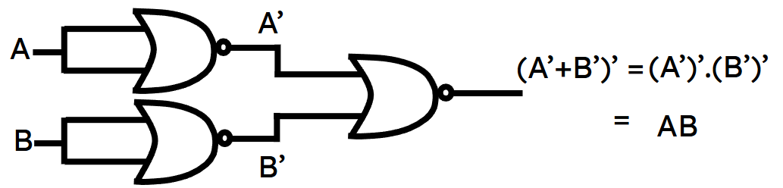
Department of Computer Science and Engineering, BRAC University
Lecture 3
Logic Gates & Boolean Algebra
CSE260 : Digital Logic Design

Slide 2
Binary Logic
Binary logic consists of binary variables and logical operations.
Variables are designated by letters such as A, B, C, x, y, z etc. with only 2 possible values: 1 and 0.
Logic operations: and, or, not etc.
‹#›
Department of Computer Science and Engineering
CSE260 - Digital Logic Design

Slide 3
Logic Gates
The most basic digital devices are called gates.
A gate has one or more inputs and produces an output that is a function of the current input values.
The relationship between the input and the output is based on a certain logic.
‹#›
Department of Computer Science and Engineering
CSE260 - Digital Logic Design

Slide 4
Truth Table
Provides a listing of every possible combination of inputs and its corresponding outputs.
INPUTS | OUTPUTS
... | ...
... | ...
‹#›
Department of Computer Science and Engineering
CSE260 - Digital Logic Design

Slide 5
All Logic Gates
NOT | Basic Gates
AND
OR
NAND | Universal Gates
NOR
XOR | Exclusive Gates
XNOR
‹#›
Department of Computer Science and Engineering
CSE260 - Digital Logic Design

Slide 6
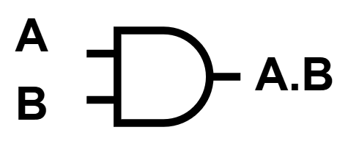
2-input AND gate
A | B | A.B
0 | 0 | 0
0 | 1 | 0
1 | 0 | 0
1 | 1 | 1
1 = on
0 = off
Output will be 1 only when both inputs are 1
‹#›
Department of Computer Science and Engineering
CSE260 - Digital Logic Design

Slide 7
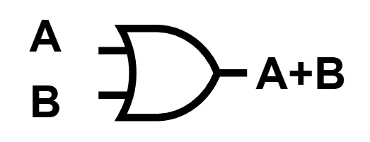
2-input OR gate
A | B | A+B
0 | 0 | 0
0 | 1 | 1
1 | 0 | 1
1 | 1 | 1
1 = on
0 = off
Output will be 1 when at least one input is 1
‹#›
Department of Computer Science and Engineering
CSE260 - Digital Logic Design

Slide 8

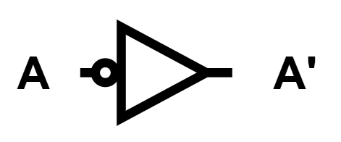
NOT gate (Inverter)
A | A’
0 | 1
1 | 0
1 = on
0 = off
Output will be the inverse of the input
‹#›
Department of Computer Science and Engineering
CSE260 - Digital Logic Design

Slide 9
Universal & Exclusive Gate
NAND and NOR are also known as universal gates
A universal gate is a gate which can implement any other gate
XOR and XNOR are known as Exclusive Gates
An exclusive gate is a gate that outputs based on exclusive input conditions
‹#›
Department of Computer Science and Engineering
CSE260 - Digital Logic Design

Slide 10
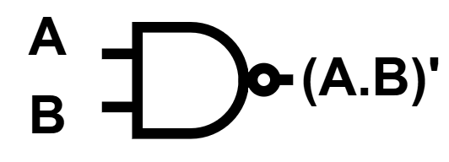
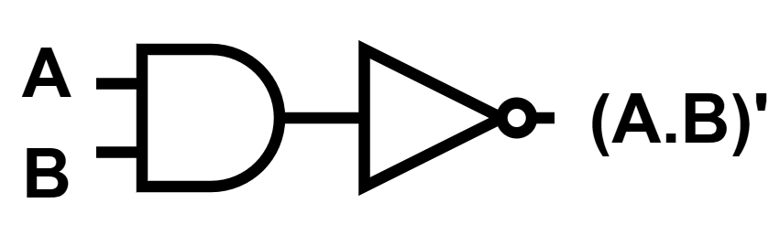
2-input NAND gate
A | B | (A.B)’
0 | 0 | 1
0 | 1 | 1
1 | 0 | 1
1 | 1 | 0
1 = on
0 = off
Inverse of AND.
Output will be 1 when at least one input is 0
‹#›
Department of Computer Science and Engineering
CSE260 - Digital Logic Design

Slide 11
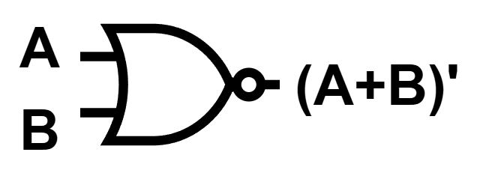
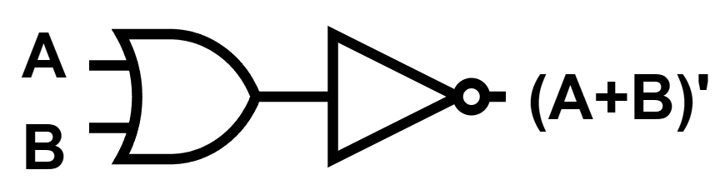
2-input NOR gate
A | B | (A+B)’
0 | 0 | 1
0 | 1 | 0
1 | 0 | 0
1 | 1 | 0
1 = on
0 = off
Inverse of OR
Output will be 1 when all input is 0
‹#›
Department of Computer Science and Engineering
CSE260 - Digital Logic Design

Slide 12
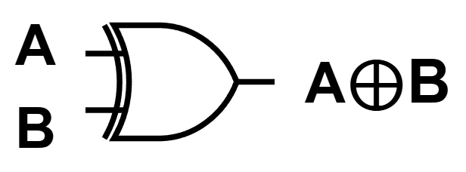
2-input XOR gate
A | B | A⊕B
0 | 0 | 0
0 | 1 | 1
1 | 0 | 1
1 | 1 | 0
1 = on
0 = off
Output will be 1 for odd number of 1s in input
Trivia: Do you know that A⊕B and A’B+AB’ are the same thing? Create the truth table to verify.
‹#›
Department of Computer Science and Engineering
CSE260 - Digital Logic Design

Slide 13

2-input XNOR gate
A | B | A⊙B
0 | 0 | 1
0 | 1 | 0
1 | 0 | 0
1 | 1 | 1
1 = on
0 = off
Inverse of XOR
Trivia: Do you know that A⊙B and AB+A’B’ are the same thing? Create the truth table to verify.
‹#›
Department of Computer Science and Engineering
CSE260 - Digital Logic Design

Slide 14
Proof using Truth Table
Prove that: x . (y + z) = (x . y) + (x . z)
(i) Construct truth table for LHS & RHS of above equality.
(ii) Check that LHS = RHS
Postulate is SATISFIED because output column 5 & 8 (for LHS & RHS expressions) are equal for all cases.
x | y | z | y+z | x.(y+z) | x.y | x.z | (x.y)+(x.z)
0 | 0 | 0 | 0 | 0 | 0 | 0 | 0
0 | 0 | 1 | 1 | 0 | 0 | 0 | 0
0 | 1 | 0 | 1 | 0 | 0 | 0 | 0
0 | 1 | 1 | 1 | 0 | 0 | 0 | 0
1 | 0 | 0 | 0 | 0 | 0 | 0 | 0
1 | 0 | 1 | 1 | 1 | 0 | 1 | 1
1 | 1 | 0 | 1 | 1 | 1 | 0 | 1
1 | 1 | 1 | 1 | 1 | 1 | 1 | 1
‹#›
Department of Computer Science and Engineering
CSE260 - Digital Logic Design

Slide 15
BOOLEAN ALGEBRA
‹#›
Department of Computer Science and Engineering
CSE260 - Digital Logic Design

Slide 16
Boolean Algebra
Like any other deductive mathematical system, defined with a set of elements, a set of operators and a number of axioms or postulates.
In Boolean algebra, set consists at least 2 variables say x & y, with 2 binary operations {+} and {.} and 1 unary operation {‘}
‹#›
Department of Computer Science and Engineering
CSE260 - Digital Logic Design

Slide 17
Basic Theorems of Boolean Algebra
Theorems can be proved using the truth table method. (Exercise: Prove De-Morgan’s theorem using the truth table.)
They can also be proved by algebraic manipulation using axioms/postulates or other basic theorems.
‹#›
Department of Computer Science and Engineering
CSE260 - Digital Logic Design

Slide 18
Postulates and Theorems of Boolean Algebra
Postulate 2: Identity | (a) x + 0 = x | (b) x . 1 = x
Postulate 3: Commutative | (a) x + y = y + x | (b) x . y = y . x
Postulate 4: Distributive | (a) x(y+z) = xy + xz | (b) x + yz = (x+y).(x+z)
Postulate 5: Complement | (a) x + x’ = 1 | (b) x . x’ = 0
Theorem 1: | (a) x + x = x | (b) x . x = x
Theorem 2: | (a) x + 1 = 1 | (b) x . 0 = 0
Theorem 3: Involution | (x’)’ = x
Theorem 4: Associative | (a) x+(y+z) = (x+y) +z | (b) x.(y.z) = (x.y).z
Theorem 5: DeMorgan | (a) (x + y)’ = x’ . y’ | (b) (xy)’ = x’ + y’
Theorem 6: Absorption | (a) x + xy = x | (b) x. (x + y) = x
All are very very important!
‹#›
Department of Computer Science and Engineering
CSE260 - Digital Logic Design

Slide 19
Basic Theorems of Boolean Algebra
Theorem 2a can be proved by:
x + 1= x+(x+x’) (complement)
= (x+x)+x’ (Th. 4)
= x+x’ (complement)
= 1
By duality, theorem 2b:
x.(0)= 0
Note: There can be other ways of making this proof. See Morris Mano
‹#›
Department of Computer Science and Engineering
CSE260 - Digital Logic Design

Slide 20
Basic Theorems of Boolean Algebra
Theorem 6a (absorption) can be proved by:
x + x.y = x.1 + x.y (identity)
= x.(1 + y) (distributivity)
= x.(y + 1) (commutativity)
= x.1 (Theorem 2a)
= x (identity)
By duality, theorem 6b:
x.(x+y) = x
Try prove this by algebraic manipulation.
‹#›
Department of Computer Science and Engineering
CSE260 - Digital Logic Design

Slide 21


Duality
Duality Principle – every valid Boolean expression (equality) remains valid if the operators and identity elements are interchanged, as follows:
+ ↔ .
1 ↔ 0
Example: Given the expression
a + (b.c) = (a+b).(a+c)
then its dual expression is
a . (b+c) = (a.b) + (a.c)
‹#›
Department of Computer Science and Engineering
CSE260 - Digital Logic Design

Slide 22
Duality
Duality gives free theorems –
“two for the price of one”.
You prove one theorem and the other comes for free!
If (x+y+z)' = x'.y.'z' is valid, then its dual is also valid:
(x.y.z)' = x'+y'+z’
If x + 1 = 1 is valid, then its dual is also valid:
x . 0 = 0
‹#›
Department of Computer Science and Engineering
CSE260 - Digital Logic Design

Slide 23
Operator Precedence
Parenthesis
Highest
NOT
AND
OR
Lowest
‹#›
Department of Computer Science and Engineering
CSE260 - Digital Logic Design

Slide 24
Simplification
We can simply a boolean function in the following ways
Using
Boolean Algebra
K-Map
(Lecture 5)
Tabulation
(Self-Study)
‹#›
Department of Computer Science and Engineering
CSE260 - Digital Logic Design

Slide 25
Boolean Functions (Solve ?)
Example:
F1= xyz'
F2= x + y'z
F3=(x'y'z)+(x'yz)+(xy')
F4=xy'+x'z
From the truth table, F3=F4.
Can you also prove by algebraic manipulation that F3=F4?
x | y | z | F1 | F2 | F3 | F4
0 | 0 | 0 | 0 | 0 | 0 | 0
0 | 0 | 1 | 0 | 1 | 1 | 1
0 | 1 | 0 | 0 | 0 | 0 | 0
0 | 1 | 1 | 0 | 0 | 1 | 1
1 | 0 | 0 | 0 | 1 | 1 | 1
1 | 0 | 1 | 0 | 1 | 1 | 1
1 | 1 | 0 | 1 | 1 | 0 | 0
1 | 1 | 1 | 0 | 1 | 0 | 0
‹#›
Department of Computer Science and Engineering
CSE260 - Digital Logic Design

Slide 26
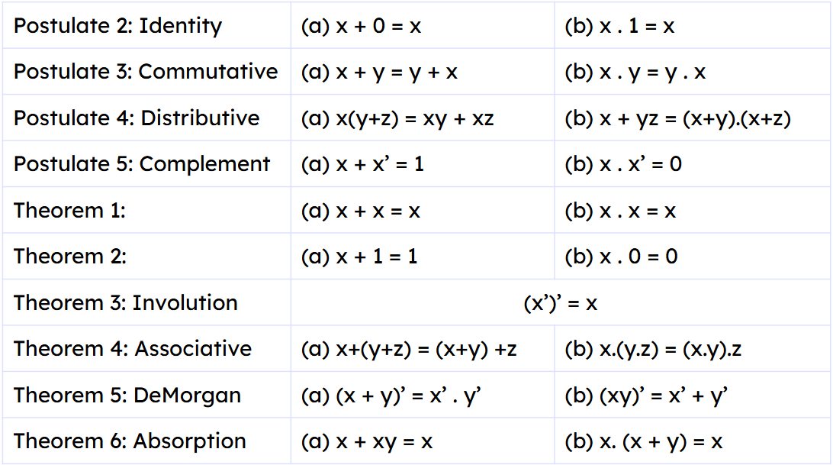
Boolean Functions (Solve ?)
If F3=(x'y'z)+(x'yz)+(xy') and F4=xy'+x'z, prove F3=F4 by algebraic manipulation.
Solution:
F3=
(x'y'z)+(x'yz)+(xy')
= x’y’z+x’yz+xy’
=x’z(y’+y)+xy’
=x’z(1)+xy’
=x’z+xy’
=F4
‹#›
Department of Computer Science and Engineering
CSE260 - Digital Logic Design

Slide 27
Try it yourself
a)Simplify to minimum literals: xy+xy’
b)Reduce to 6 literals: BC+AC’+AB+BCD
Simplify the following equations
c) x+x’y
d) x(x’+y)
e) x’y’z+x’yz+xy’
‹#›
Department of Computer Science and Engineering
CSE260 - Digital Logic Design

Slide 28
Try it yourself
Solution:
a) xy+xy’ =x(y+y’) =x(1) =x
b)BC+AC’+AB+BCD
=BC(1+D)+AC’+AB
=BC(1)+AC’+AB
=BC+AB+AC’
=B(C+A)+AC’
c) x+x’y =(x+x’).(x+y) =1.(x+y) =x+y
d) x(x’+y) =xx’+xy =0+xy =xy
e) x’y’z+x’yz+xy’ =x’z(y’+y)+xy’ =x’z+xy’
Now Try Proving Using Truth Table!!!
‹#›
Department of Computer Science and Engineering
CSE260 - Digital Logic Design

Slide 29
Complementing a function
Take dual of the function
Complement each literals
Example: F1= x’yz’+x’y’z
Dual of the function F1 is
(x’+y+z’).(x’+y’+z)
Complement each literal=
(x+y’+z)(x+y+z’)
Therefore, F1’= (x+y’+z)(x+y+z’)
Same as applying De-Morgan’s law on the function
‹#›
Department of Computer Science and Engineering
CSE260 - Digital Logic Design

Slide 30
Try it yourself
a)What is the complement of
F2=x(y’z’+yz)
Solution:
Step 1: Duality: x+(y’+z’)(y+z)
Step 2: Complement= x’+(y+z)(y’+z’)
Therefore, F2’ = x’+(y+z)(y’+z’)
‹#›
Department of Computer Science and Engineering
CSE260 - Digital Logic Design

Slide 31
More Practice
Simplify the following Boolean expression to a minimum number literals:
a) xy + xy′
b) (x + y)(x + y′)
c) xyz + x′y + xyz′
d) (A+B)′(A′+B′)′
e) (AB)′(A′ + B)(B′ + B)
f) (A + C)(AD + AD′) + AC + C
‹#›
Department of Computer Science and Engineering
CSE260 - Digital Logic Design

Slide 32
More Practice [Solution]
a) xy + xy′ = x ( y+y′)= x.1 = x
b) (x+y)(x+y′) = xx + xy′ + yx+yy′ = x + xy′ + xy + 0 = x (1+ y′ + y) = x.1= x
Also (x+y)(x+y′) =x+ yy′ = x + 0 = x
c) xyz + x′y + xyz′ = xy(z+z′) + x′y = xy +x′y = y(x+x′)=y
d) (A+B)′(A′+B′)′= (A′B′).(AB) = 0
e) A′ [Find the process yourself]
f) A + C [Find the process yourself]
‹#›
Department of Computer Science and Engineering
CSE260 - Digital Logic Design

Slide 33
Practice! Practice! Practice!
Find the complement of the following expressions:
a) xy′+x′y
b) (AB′+C)D′+E
c) (x+y′+z)(x′+z′)(x+y)
‹#›
Department of Computer Science and Engineering
CSE260 - Digital Logic Design

Slide 34
Practice! Practice! Practice!
Solution:
a) [xy′+x′y]′ = (xy′)′ . (x′y)′ = (x′+y).(x+y′) = xx′ + yy′ + xy+x’y’=xy+x’y’
b) [(AB′+C)D′+E]′ = [(AB′+C)D′]′.E′ = [(AB′+C)′+D] . E′= [(A′+B).C′ +D].E′ =
= (A′+B+D).(C′+D).E′
c) [(x+y′+z)(x′+z′)(x+y)]′ = (x+y′+z)′+(x′+z′)′+(x+y)′= x′yz′ + xz + x′y′
Note: If the question doesn’t ask you to simplify,
then you don’t need to simplify after complement.
‹#›
Department of Computer Science and Engineering
CSE260 - Digital Logic Design

Slide 35
Using NAND and NOR to Build Other Gates and Functions
‹#›
Department of Computer Science and Engineering
CSE260 - Digital Logic Design

Slide 36
Basic gates using NAND gate
A
(AB)’
B
NOT
A
A’
A
(AA)’ =
A’
AND
A
A
(AB)’
B
AB
((AB)’)’ =
AB
B
A
A’
A
(A’B’)’ =
(A’)’+(B’)’
OR
A+B
B
=
A+B
B
B’
‹#›
Department of Computer Science and Engineering
CSE260 - Digital Logic Design

Slide 37
Basic gates using NOR gate
A
(A+B)’
B
A
A’
NOT
A
A’
(A+A)’ =
OR
A
A
(A+B)’
A+B
A+B
B
((A+B)’)’ =
B
A’
A
A
(A’+B’)’ =
(A’)’.(B’)’
AND
B
AB
=
AB
B
B’
‹#›
Department of Computer Science and Engineering
CSE260 - Digital Logic Design

Slide 38

Exercise
Use AND, OR, NOT to represent F=A(B+CD)+BC’
A
B
C
D
CD
B+CD
A(B+CD)
C’
A(B+CD)+BC’
BC’
‹#›
Department of Computer Science and Engineering
CSE260 - Digital Logic Design

Slide 39
Use NAND to Implement A Function
Steps:
If an expression is given, represent it using AND,OR and NOT gates
Draw each gate with equivalent NAND representation
Remove any 2 cascading inverters
Remove inverters from single input connection and replace input with its complement.
Tutorial
‹#›
Department of Computer Science and Engineering
CSE260 - Digital Logic Design

Slide 40
Exercise
A
A’
Use NAND to represent F=A(B+CD)+BC’
A
AB
A
B
C
D
B
CD
B+CD
A
A+B
B
A(B+CD)
A(B+CD) +BC’
BC’
‹#›
Department of Computer Science and Engineering
CSE260 - Digital Logic Design

Slide 41
Use NOR to Implement A Function
Steps:
If an expression is given, represent it using AND,OR and NOT gates
Draw each gate with equivalent NOR representation
Remove any 2 cascading inverters
Remove inverters from single input connection and replace input with its complement.
Tutorial
‹#›
Department of Computer Science and Engineering
CSE260 - Digital Logic Design

Slide 42
Exercise
A
A’
Use NOR to represent F=A(B+CD)+BC’
A
A+B
A
B
C
D
B
CD
A
B+CD
AB
B
A(B+CD)
C’
BC’
A(B+CD)+BC’
‹#›
Department of Computer Science and Engineering
CSE260 - Digital Logic Design

